Slide 1
Magnetic Domain-Wall Racetrack Memory
江 鹏
1601110075
2017.12.15

Slide 2
outline
1、Background of Racetrack Memory
2、How it works?
3、Domain Walls Motion
4、Summary

Slide 3
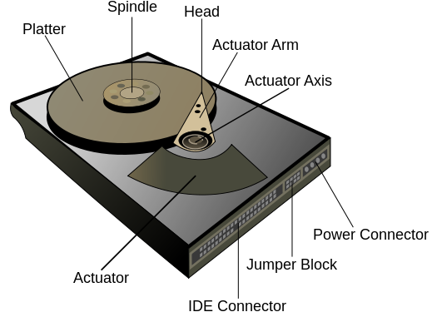
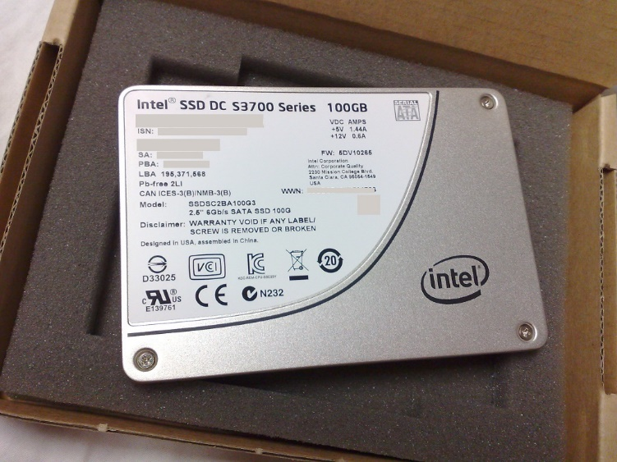
Background of Racetrack Memory
Hard Disk Drive
Solid State Drive
Slow but cheap
Fast but expensive

Slide 4
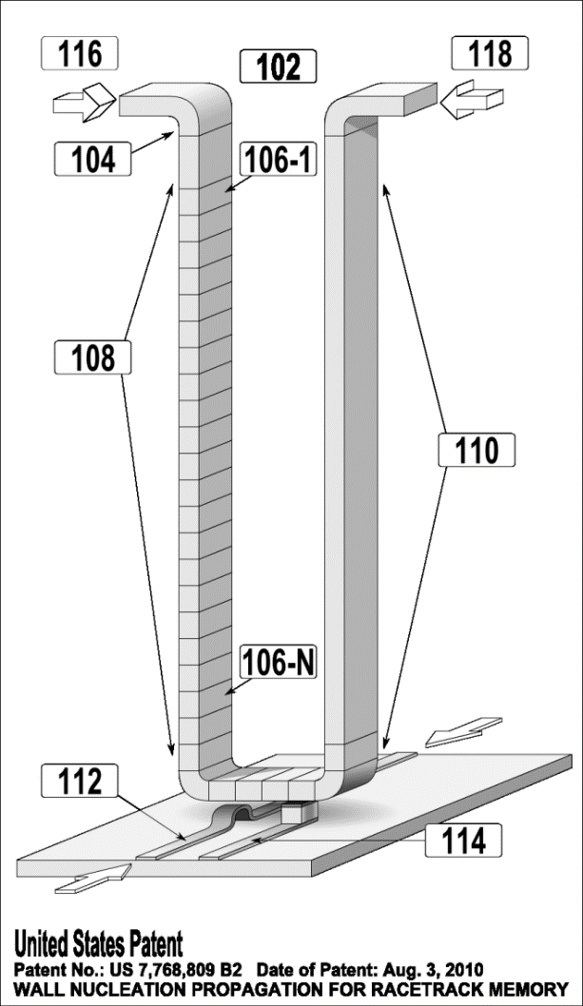
Racetrack Memory
Racetrack memory or domain-wall memory (DWM) is an experimental non-volatile memory device under development at IBM's Almaden Research Center by a team led by physicist Stuart Parkin.
Cheap
3D Storage
Nonvolatile
High performance

Slide 5
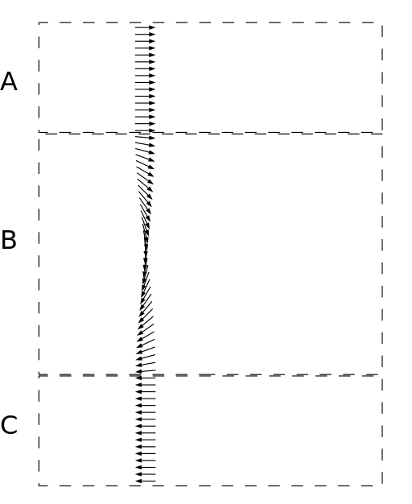
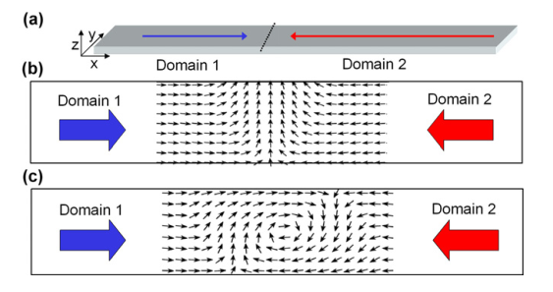
Domain wall
Head to Head
M Kläui 2008 J. Phys.: Condens. Matter 20 313001
(b) Anticlockwise Transverse DM
(c) Clockwise Vortex DM

Slide 6
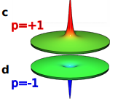
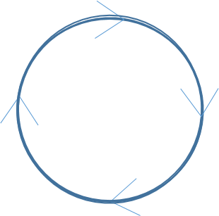
Polarity of Vortex DW (core)
Affect the motion of DWs
Chirality of Vortex DM

Slide 7
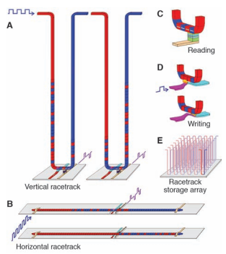
How it works?
Structure: magnetic nanowires + magnetic domains
Read: MTJ
Write: self-field of current、spin-momentum transfer torque
fringing field
S. P. et.al Science 320 (5873), 190-194.

Slide 8
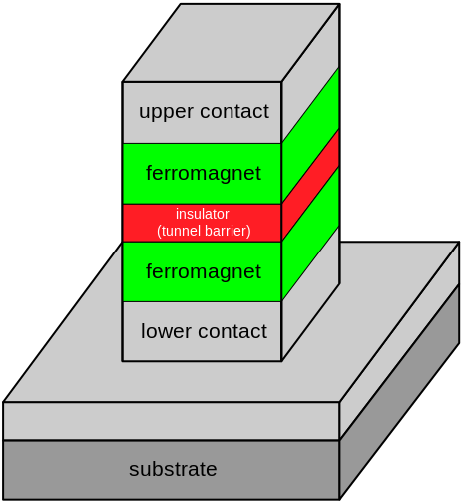
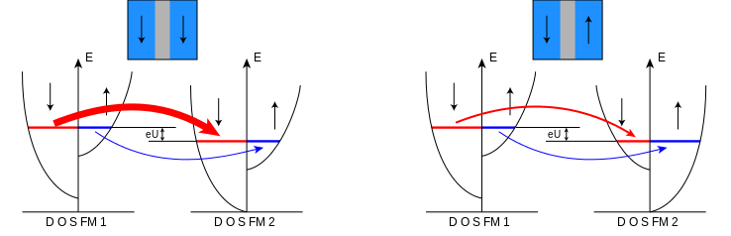
MTJ (magnetic tunnel junction)
Joulie model

Slide 9

Magnetic Nanowires
Pining sites
Control the domain walls’ spacing
“V” or “T” DW depend on width and thickness
“V”is favored in thicker and wider nanowires
Hayashi, Masamitsu, et al. Nature Physics 3.1 (2007): 21-25.

Slide 10
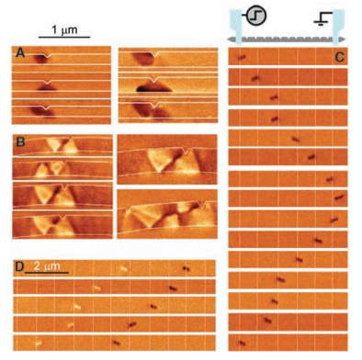
Domain Walls Motion
(C)
1、40-nm-thick, 100-nm-wide permalloy nanowire with 11 triangular notches located 1 mm apart ,
2、Single current pulses, 8V (26 mA) and 14 ns long, were applied between each image sequentially from top to bottom (D)
The motion of two DWs in the same nanowire as (C). Positive current pulses (26 mA, 14 ns long) were applied between successive images sequentially from top to bottom
the motion of the DWs is not reliable！

Slide 11
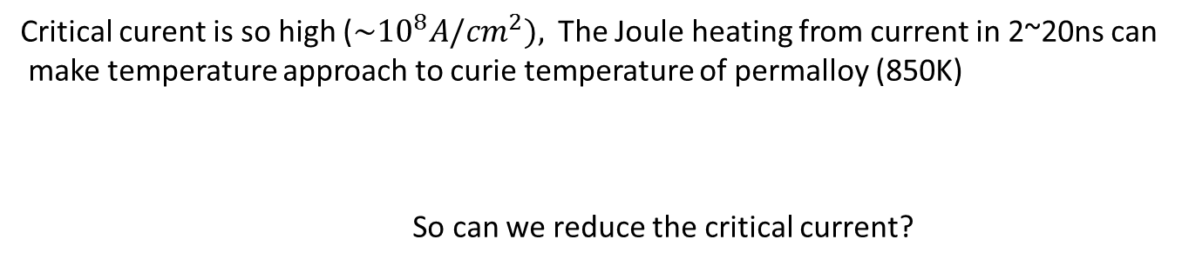
Critical curent is so high (${\sim 10}^{8}A/{cm}^{2}),$The Joule heating from current in 2~20ns can
make temperature approach to curie temperature of permalloy (850K)
So can we reduce the critical current?

Slide 12
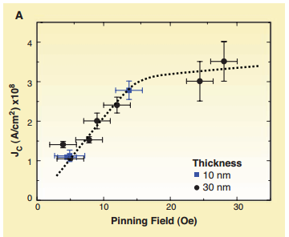
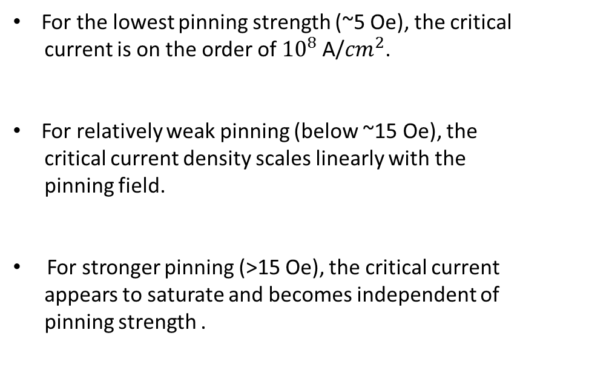
For the lowest pinning strength (~5 Oe), the critical
current is on the order of ${10}^{8}$A/${cm}^{2}$.
For relatively weak pinning (below ~15 Oe), the
critical current density scales linearly with the
pinning field.
For stronger pinning (>15 Oe), the critical current
appears to saturate and becomes independent of
pinning strength .

Slide 13
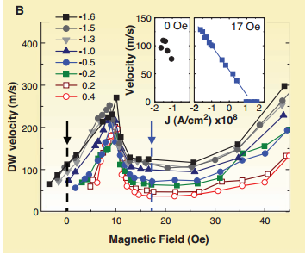
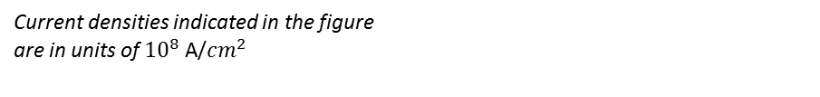
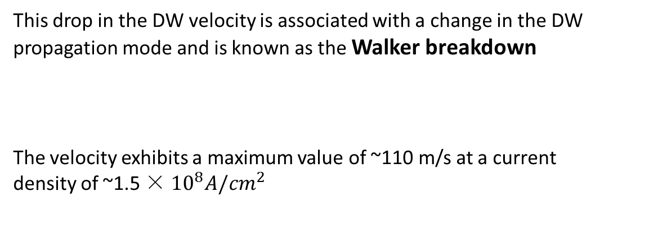
The DW velocity peaks at a relatively low magnetic field (~10 Oe)
This drop in the DW velocity is associated with a change in the DW propagation mode and is known as the Walker breakdown
The velocity exhibits a maximum value of ~110 m/s at a current density of ~1.5 × ${10}^{8}A/{cm}^{2}$
Current densities indicated in the figure are in units of ${10}^{8}$A/${cm}^{2}$

Slide 14
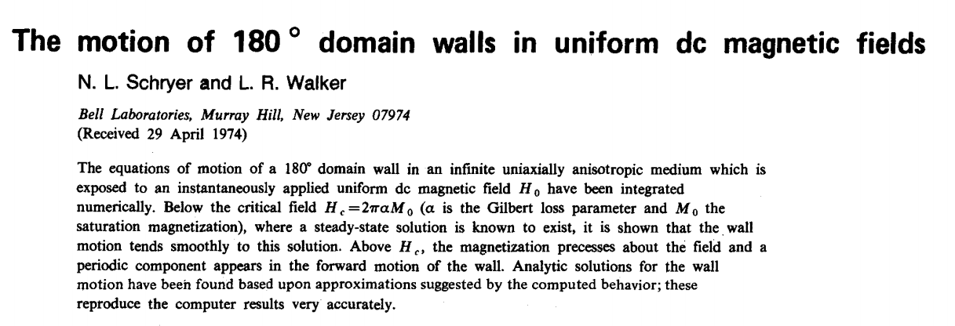
Walker breakdown

Slide 15
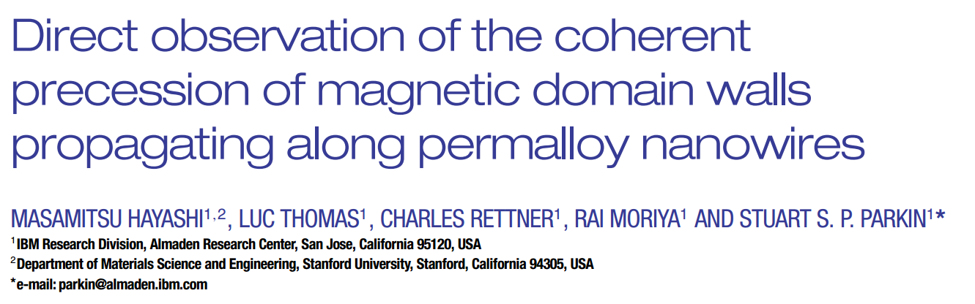
Observation

Slide 16
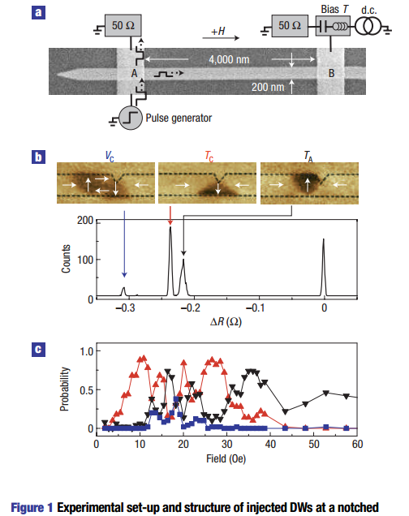

Slide 17
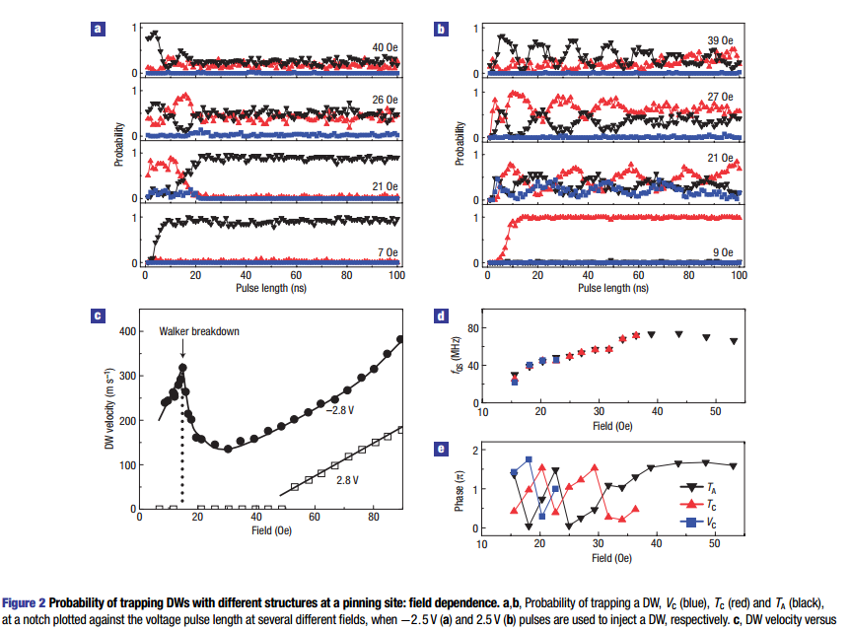
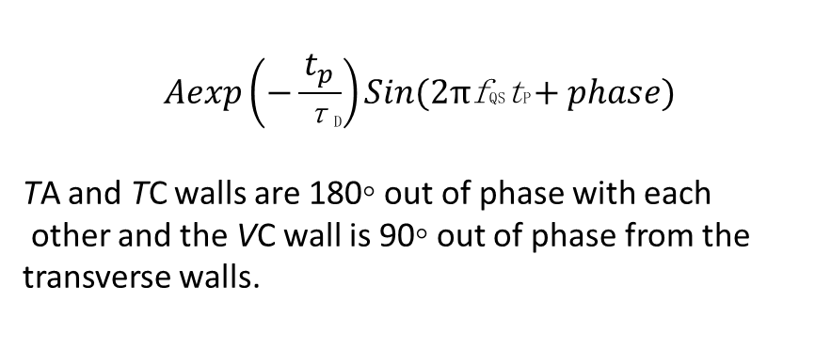
$$Aexp\left(−\frac{t_{p}}{\text{τ}\text{D}}\right)Sin(2π\text{f}\text{QS}\text{t}\text{P}+phase)$$
TA and TC walls are 180◦ out of phase with each
other and the VC wall is 90◦ out of phase from the transverse walls.

Slide 18
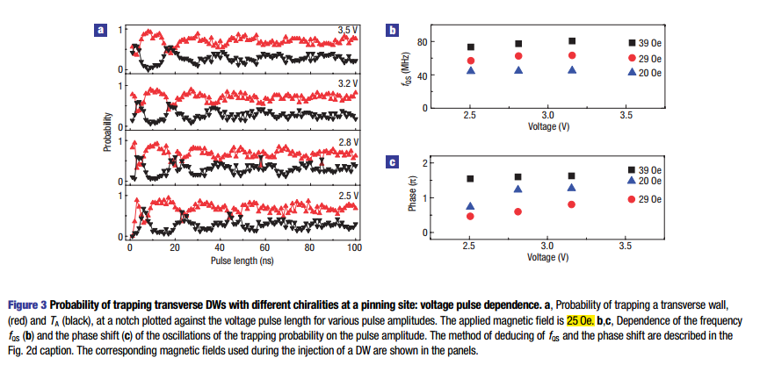

Slide 19
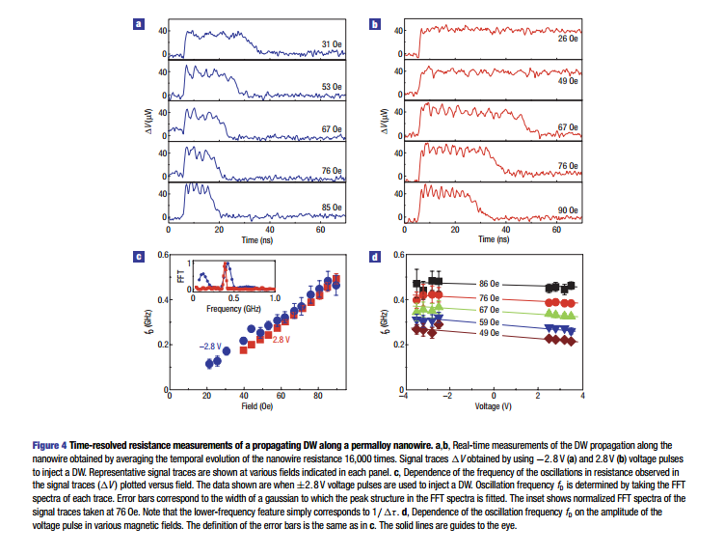

Slide 20
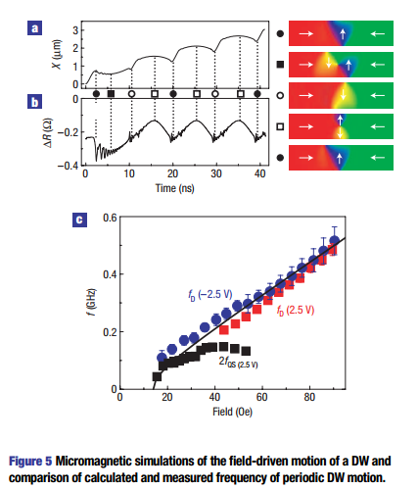
Conclusion:
oscillations are observed only when the field exceeds the Walker breakdown field (∼14 Oe)
The DW state oscillates periodically from a transverse wall of one chirality to a transverse wall of the opposite
polarity via a vortex wall or an anti-vortex wall state
the oscillations seen in the real-time measurements of
the DW motion represent periodic variations in the DW
structure as the DW propagates along the nanowire

Slide 21
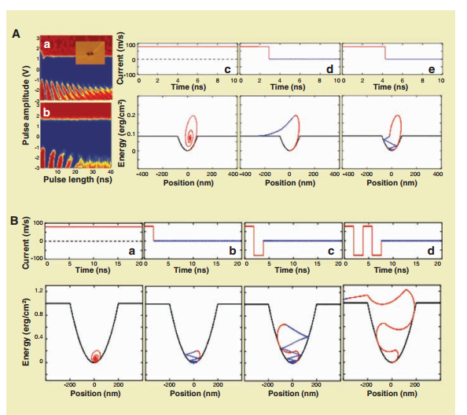
Resonant Amplification of DW Motion
A novel method for lowering the critical current density of pinned DWs was recently demonstrated, which involves using short current pulses with particular lengths, matched to the innate precessional frequency of the pinned DW
When the current pulse length is matched to approximately
a half integer of the DW’s precessional period tp (such as 1/2, 3/2, 5/2, etc.), the DW can have sufficient energy to be driven out of the pinning site.

Slide 22
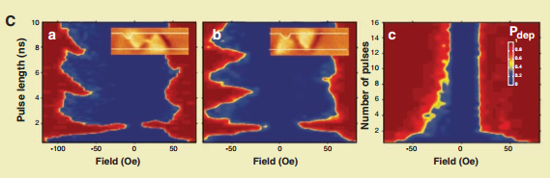
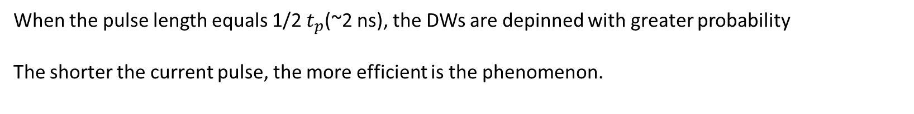
When the pulse length equals 1/2 $t_{p}$(~2 ns), the DWs are depinned with greater probability
The shorter the current pulse, the more efficient is the phenomenon.

Slide 23
Summary
1、3D Racetrack Memory may overcome the limitations of the further scaling of complementary metal oxide semiconductor transistors.
2、RM has great performace, the average access time of RM will be 10 to 50 ns, as compared to 5 ms for an HDD and perhaps ~10 ns for advanced MRAM .
3、There are also many challenges such as, interaction of spin-polarized current with magnetic moments...

Slide 24
Reference
Parkin S S P, Hayashi M, Thomas L. Magnetic domain-wall racetrack memory[J]. Science, 2008, 320(5873): 190-194.
Hayashi M, Thomas L, Rettner C, et al. Direct observation of the coherent precession of magnetic domain walls propagating along permalloy nanowires[J]. Nature Physics, 2007, 3(1): 21-25.
Schryer N L, Walker L R. The motion of 180 domain walls in uniform dc magnetic fields[J]. Journal of Applied Physics, 1974, 45(12): 5406-5421.
Kläui M. Head-to-head domain walls in magnetic nanostructures[J]. Journal of Physics: Condensed Matter, 2008, 20(31): 313001.

Slide 25
Thanks for your attention!

